Slide 1
Quadratic functions
Lesson 1 – axis of symmetry & vertex

Slide 2
objective
Find the Axis of Symmetry of a quadratic function
Find the vertex of a quadratic function

Slide 3
definitions
The standard form of a quadratic equation is
The curve formed by a quadratic equation is called a
Parabola

Slide 4
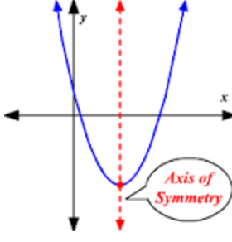
definitions
The formula for the axis of symmetry is
The axis of symmetry is an imaginary line that divides the parabola in half

Slide 5
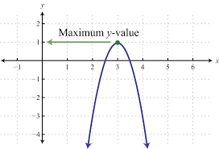
definitions
If the vertex is the hightest point on the graph, it is called a
Maximum

Slide 6
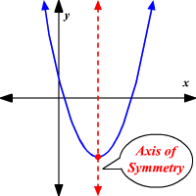
definitions
If the vertex is the lowest point on the graph, it is called a
Minimum

Slide 7
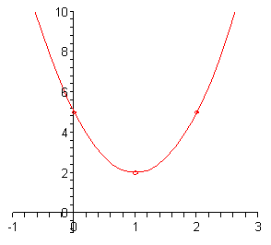
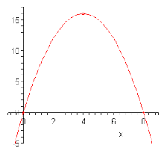
Sketch the following by finding the aos, vertex, and details about ‘a’
Recall:
If ‘a’ is positive the graph is concave up
If ‘a’ is negative, the graph is concave down
If |a| <1 then the graph will be wider than normal
If |a| > 1 then the graph will be skinnier than normal

Slide 8
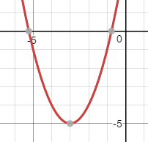
1
6
4
a = __________________ b = _______________ c = ___________
Opening: _______________________
Skinnier, wider, regular? __________________________
Axis of symmetry
y-coordinate of the vertex:
Vertex:
Sketch:
Upward; vertex will be minimum
regular
(-3, -5)

Slide 9
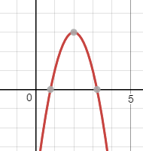
-2
8
-5
a = __________________ b = _______________ c = ___________
Opening: _______________________
Skinnier, wider, regular? __________________________
Axis of symmetry
y-coordinate of the vertex:
Vertex:
Sketch:
Downward; vertex will be maximum
skinnier
(2, 3)

Slide 10
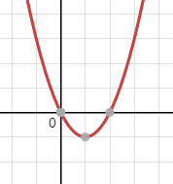
1
-2
0
a = __________________ b = _______________ c = ___________
Opening: _______________________
Skinnier, wider, regular? __________________________
Axis of symmetry
y-coordinate of the vertex:
Vertex:
Sketch:
Upward; vertex will be minimum
regular
(1, -1)

Slide 11
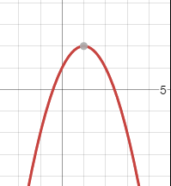
-1
-8
-9
a = __________________ b = _______________ c = ___________
Opening: _______________________
Skinnier, wider, regular? __________________________
Axis of symmetry
y-coordinate of the vertex:
Vertex:
Sketch:
Downward; vertex will be maximum
regular
(-4, 7)

Slide 12
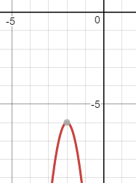
-5
-20
-26
a = __________________ b = _______________ c = ___________
Opening: _______________________
Skinnier, wider, regular? __________________________
Axis of symmetry
y-coordinate of the vertex:
Vertex:
Sketch:
Downward; vertex will be maximum
Skinnier
(-2, -6)

Slide 13
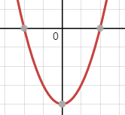
1
0
-4
a = __________________ b = _______________ c = ___________
Opening: _______________________
Skinnier, wider, regular? __________________________
Axis of symmetry
y-coordinate of the vertex:
Vertex:
Sketch:
Upward; vertex will be minimum
Regular
(0, -4)

Slide 14
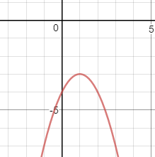
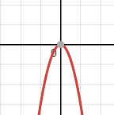
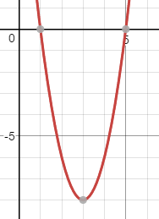
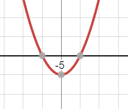
You Try #’s 12 - 15
(1, -3) 13. (0, 0)
14. (3, 8) 15.

Slide 15
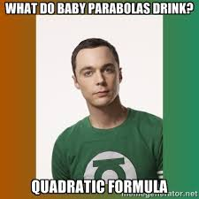
Homework
Day 1 HW page 3

