Slide 1
System of Equations “Fly-Swatter” Bingo!
Play!
© Gina Wilson, 2012

Slide 2
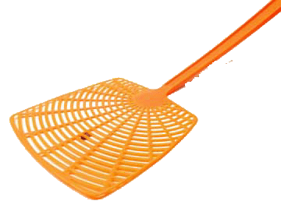
© Gina Wilson, 2012

Slide 3
1
ANSWER
BACK
© Gina Wilson, 2012

Slide 4
2
ANSWER
BACK
© Gina Wilson, 2012

Slide 5
3
ANSWER
BACK
© Gina Wilson, 2012

Slide 6
4
ANSWER
BACK
© Gina Wilson, 2012

Slide 7
5
ANSWER
BACK
© Gina Wilson, 2012

Slide 8
6
ANSWER
BACK
© Gina Wilson, 2012

Slide 9
7
ANSWER
BACK
© Gina Wilson, 2012

Slide 10
8
ANSWER
BACK
© Gina Wilson, 2012

Slide 11
9
ANSWER
BACK
© Gina Wilson, 2012

Slide 12
10
ANSWER
BACK
© Gina Wilson, 2012

Slide 13
11
ANSWER
BACK
© Gina Wilson, 2012

Slide 14
12
ANSWER
BACK
© Gina Wilson, 2012

Slide 15
13
ANSWER
BACK
© Gina Wilson, 2012

Slide 16
14
ANSWER
BACK
© Gina Wilson, 2012

Slide 17
15
ANSWER
BACK
© Gina Wilson, 2012

Slide 18
16
ANSWER
BACK
© Gina Wilson, 2012

Slide 19
17
ANSWER
BACK
© Gina Wilson, 2012

Slide 20
18
ANSWER
BACK
© Gina Wilson, 2012

Slide 21
19
ANSWER
BACK
© Gina Wilson, 2012

Slide 22
20
ANSWER
BACK
© Gina Wilson, 2012

Slide 23
21
ANSWER
BACK
© Gina Wilson, 2012

Slide 24
22
ANSWER
BACK
© Gina Wilson, 2012

Slide 25
23
ANSWER
BACK
© Gina Wilson, 2012

Slide 26
24
ANSWER
BACK
© Gina Wilson, 2012

Slide 27
25
ANSWER
BACK
© Gina Wilson, 2012

