Slide 1
Graphing Quadratic Functions
Unit 6 – Day 2

Slide 2
Objective
Create a table of values to graph a quadratic function

Slide 3
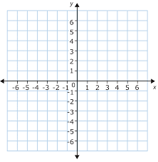

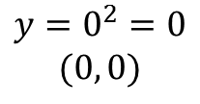

$$y=x^{2}$$
$$axis of symetry \\ x=−\frac{b}{2a}$$
a = 1 b = 0 c = 0
Axis of symmetry:
Vertex:
Domain
$$(−∞, ∞)$$
Range:
Y-intercept
$$x=\frac{0}{2\left(1\right)}=0$$
X | Y
$$y=0^{2}=0 \\ (0, 0)$$
-2
4
-1
1
0
0
1
1
2
4
$$y≥0$$
$$y=0^{2}=0$$

Slide 4
$$y=x^{2}+2x+5$$
$$axis of symetry \\ x=−\frac{b}{2a}$$
a = 1 b = 2 c = 5
Axis of symmetry:
Vertex:
Domain
$$(−∞, ∞)$$
Range:
Y-intercept
$$x=\frac{−2}{2\left(1\right)}=−1$$
X | Y
$y={(−1)}^{2}+2\left(−1\right)+5=$4 $$(−1,4)$$
-3
8
-2
5
-1
4
0
5
1
8
$$y≥4$$
$$y=0^{2}+2(0)+5=5$$

Slide 5
$$y={−x}^{2}−8x−17$$
$$axis of symetry \\ x=−\frac{b}{2a}$$
a = -1 b = -8 c = -17
Axis of symmetry:
Vertex:
Domain
$$(−∞, ∞)$$
Range:
Y-intercept
$x=\frac{−(−8)}{2\left(−1\right)}=−$4
X | Y
$$y={−(−4)}^{2}−8\left(−4\right)−17=−1 \\ (−4,−1)$$
-6
-5
-5
-2
-4
-1
-3
-2
-2
-5
$y≤−$1
$$y={−0}^{2}−8\left(0\right)−17=−17$$

Slide 6
$$y={−2x}^{2}+4x+1$$
$$axis of symetry \\ x=−\frac{b}{2a}$$
a = -2 b = 4 c = 1
Axis of symmetry:
Vertex:
Domain
$$(−∞, ∞)$$
Range:
Y-intercept
$x=\frac{−(4)}{2\left(−2\right)}=$1
X | Y
$$y={−2(1)}^{2}+4\left(1\right)+1=3 \\ (1, 3)$$
-1
-5
0
1
1
3
2
1
3
-5
$$y≤3$$
$$y={−2(0)}^{2}+4\left(0\right)+1=1$$

Slide 7
$$y=x^{2}−6x+13$$
$$axis of symetry \\ x=−\frac{b}{2a}$$
a = 1 b = -6 c = 13
Axis of symmetry:
Vertex:
Domain
$$(−∞, ∞)$$
Range:
Y-intercept
$x=\frac{−(−6)}{2\left(1\right)}=$3
X | Y
$$y={(3)}^{2}−6\left(3\right)+13=4 \\ (3, 4)$$
1
8
2
5
3
4
4
5
5
8
$y≥$4
$$y={(0)}^{2}−6\left(0\right)+13=13$$

Slide 8
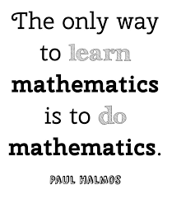
You Try
Complete #’s 6 – 10. Be sure to find the y-intercept as well.

Slide 9
Answers

